Slide 1
Chapter – 6
Transform and Conquer
By Dr. Shashikumar G. Totad

Slide 2
Chapter – 6
Transform and Conquer
Contents
Presorting,
Balanced Search Trees,
Heaps and Heapsort,
Problem Reduction

Slide 3
Transform and Conquer
Transform and Conquer methods work as two-stage procedures.
First: The problem’s instance is modified to be, for one reason or another, more amenable to solution.
Second: in the conquering stage, it is solved.
Variations of Decrease and Conquer - There are three major variations of decrease-and-conquer:
Instance simplification : Transformation to a simpler or more convenient instance of the
same problem; Example- presorting, Binary search tree to Balanced Search Trees(AVL trees).
Representation change: Transformation to a different representation of the same instance.
Example- array to binary search tree,2-3 trees, 2-3-4 trees, B-trees.
Problem reduction: Transformation to an instance of a different problem for which an algorithm is already available.

Slide 4
1. Presorting
Many questions about a list are easier to answer if the list is sorted.
Time efficiency of algorithms that involve sorting may depend on the efficiency of the sorting
algorithm being used.
EXAMPLE 1: Checking element uniqueness in an array .
Sort the array first and then check only its consecutive elements: if the array has equal elements, a pair of them must be next to each other, and vice versa.
ALGORITHM PresortElementUniqueness(A[0..n − 1])
//Solves the element uniqueness problem by sorting the array first //Input: An array A[0..n − 1] of orderable elements
//Output: Returns “true” if A has no equal elements, “false” otherwise sort the array A
for i ←0 to n−2 do
if (A[i]= A[i +1])
return false
return true

Slide 5
1. Presorting
Running time of this algorithm is the sum of the time spent on sorting and the time spent on checking consecutive elements.
Since the former requires at least n log n comparisons and the latter needs no more than n −1comparisons,
it is the sorting part that will determine the overall efficiency of the algorithm.
Worst-case efficiency of the entire presorting-based algorithm will be also in (nlog n):
T(n) =T_{sort}(n) + T_{scan}(n) ∈ θ(n log n) + θ (n)=θ (n logn).

Slide 6

1. Presorting
EXAMPLE 2 - Computing a mode:
A mode is a value that occurs most often in a given list of numbers. For example, for 5, 1, 5, 7, 6, 5, 7, the mode is 5.
The brute-force approach to computing a mode would scan the list and compute the frequencies of all its distinct values, then find the value with the largest frequency.
Worst-case input for brute-force algorithm is a list with no equal elements.
For such a list, its i^{th} element is compared with i − 1 elements of the auxiliary list of distinct values seen so far, before being added to the list with a frequency of 1.
As a result, the worst-case number of comparisons made by this algorithm in creating the frequency list is:
The additional n −1 comparisons needed to find the largest frequency in the auxiliary list do not change the quadratic worst-case efficiency class of the algorithm.

Slide 7
1. Presorting
EXAMPLE 2- Computing a mode: . . .
Alternative approach:
First sort the input, so that all the equal values are adjacent to each other.
To compute the mode, find the longest run of adjacent equal values in the sorted array.
ALGORITHM PresortMode(A[0..n−1])
//Computes the mode of an array by sorting it first
//Input: An array A[0..n − 1]of orderable elements
//Output: The array’s mode
;
;
;
;
;
sort the array A
i ←0 //current run begins at position i
modefrequency ←0 //highest frequency seen so far
while (i ≤ n−1) do
runlength ←1; runvalue ←A[i]
while (i +runlength ≤ n−1 and A[i +runlength]=runvalue)
runlength ←runlength +1
if runlength >modefrequency
modefrequency ←runlength; modevalue ←runvalue
i ←i+runlength
return modevalue

Slide 8
1. Presorting
EXAMPLE 3 - Searching:
Consider the problem of searching for a given value v in a given array of n sortable items.
The brute-force solution here is sequential search , which needs n comparisons in the worst case.
If the array is sorted first, we can then apply binary search, which requires only log₂ (n )+1 comparisons in the worst case.
Assuming the most efficient n log n sort, the total running time of such a searching algorithm in the worst case will be:

Slide 9
Chapter – 6
Transform and Conquer
Contents
Presorting,
Balanced Search Trees,
Heaps and Heapsort,
Problem Reduction

Slide 10
2. Balanced Search Trees
A binary search tree is a binary tree whose nodes contain elements of a set of orderable items, one element per node, so that all elements in the left subtree are smaller than the element in the subtree’s root, and all the elements in the right subtree are greater than it.
Note that this transformation from a set to a binary search tree is an example of the representation-change
technique.
Unbalanced binary search tree is transformed into a balanced one.
Because of this, such trees are called self-balancing.
An AVL tree, a Balanced Search Tree, requires the difference between the heights of the left and right subtrees of every node never exceed 1.

Slide 11
2. Balanced Search Trees . . .
Operations on an AVL Tree:
Insertion
Deletion
Searching [similar to performing a search in BST]
Rotating the subtrees in an AVL Tree:
An AVL tree might get imbalanced as a result of an insert or a delete operation.
It is required to rotate an AVL tree in one of the following four ways to keep itself balanced:
Left Rotation
Right Rotation
Left-Right Rotation
Right-Left Rotation

Slide 12
2. Balanced Search Trees . . .
Insert Operation in an AVL Tree
Let the node to be inserted be w
Perform standard BST insert for w.
Starting from w, travel up and find the first unbalanced node. Let z be the first unbalanced node, y be the child of z that comes on the path from w to z and x be the grandchild of z that comes on the path from w to z.
Re-balance the tree by performing appropriate rotations on the subtree rooted with z. There can be 4 possible cases that need to be handled as x, y and z can be arranged in 4 ways.
Following are the possible 4 arrangements:
y is the left child of z and x is the left child of y (Left Left Case)
y is the left child of z and x is the right child of y (Left Right Case)
y is the right child of z and x is the right child of y (Right Right Case)
y is the right child of z and x is the left child of y (Right Left Case)

Slide 13
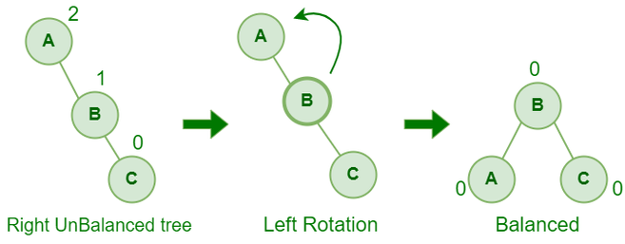
2. Balanced Search Trees . . .
Rotating the subtrees in an AVL Tree . . .
Left Rotation : When a node is added into the right subtree of the right subtree, if the tree gets out of balance, we do a single left rotation.

Slide 14
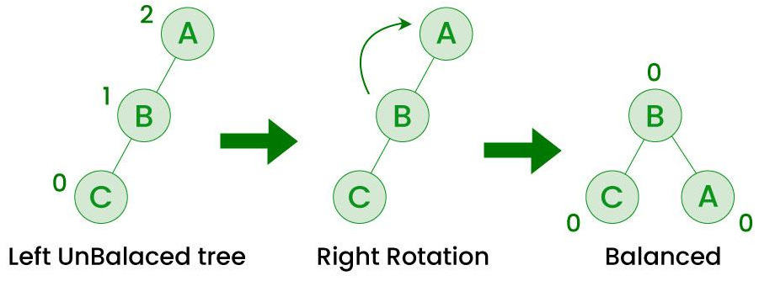
2. Balanced Search Trees . . .
Rotating the subtrees in an AVL Tree . . .
Right Rotation : If a node is added to the left subtree of the left subtree, the AVL tree may get out of balance, we do a single right rotation.

Slide 15
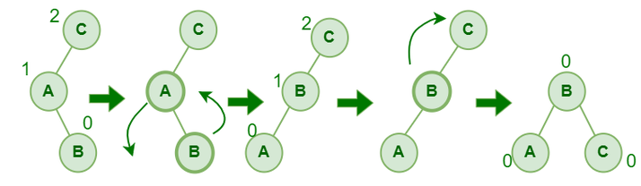
2. Balanced Search Trees . . .
Rotating the subtrees in an AVL Tree . . .
Left- Right Rotation : A left-right rotation is a combination in which first left rotation takes place after that right rotation executes.

Slide 16
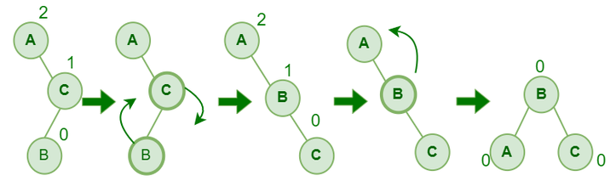
2. Balanced Search Trees . . .
Rotating the subtrees in an AVL Tree . . .
Right - Left Rotation : A right-left rotation is a combination in which first right rotation takes place after that left rotation executes.

Slide 17
2. Balanced Search Trees . . .
Rotating the subtrees in an AVL Tree . . .
Right - Left Rotation : A right-left rotation is a combination in which first right rotation takes place after that left rotation executes.

Slide 18
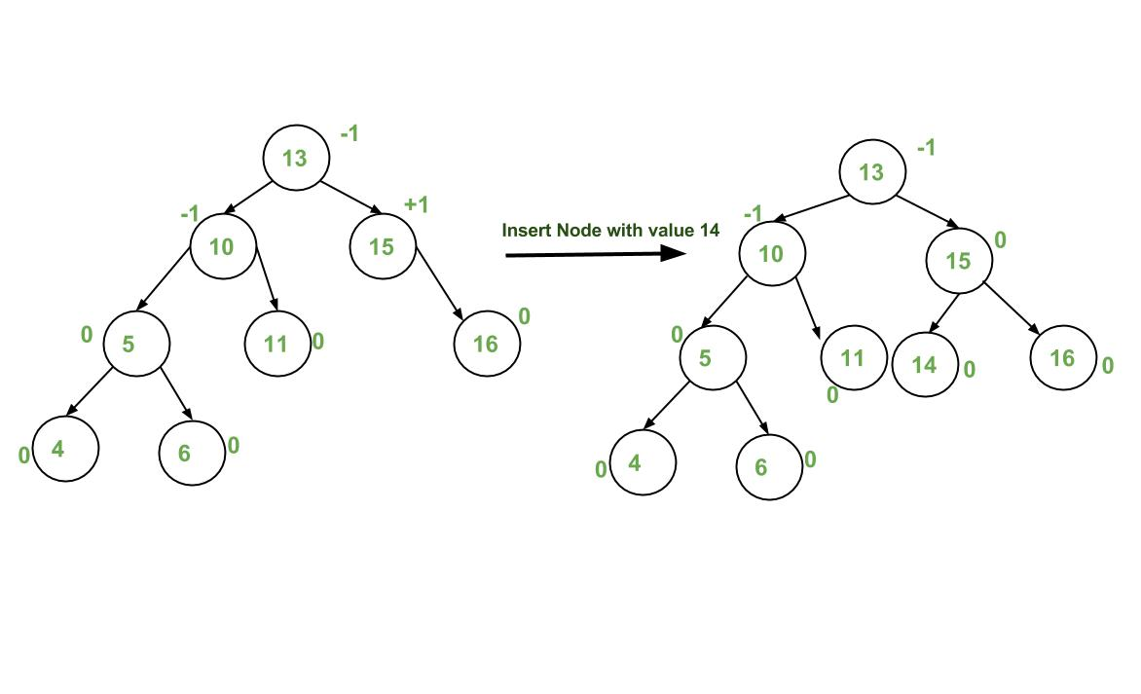
2. Balanced Search Trees . . .
Insert Operation in an AVL Tree . . .Illustration

Slide 19
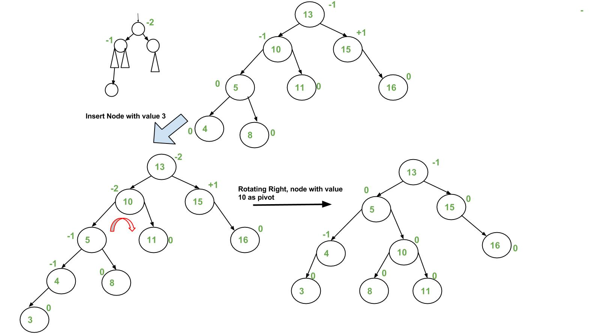
2. Balanced Search Trees . . .
Insert Operation in an AVL Tree . . .Illustration . . .

Slide 20
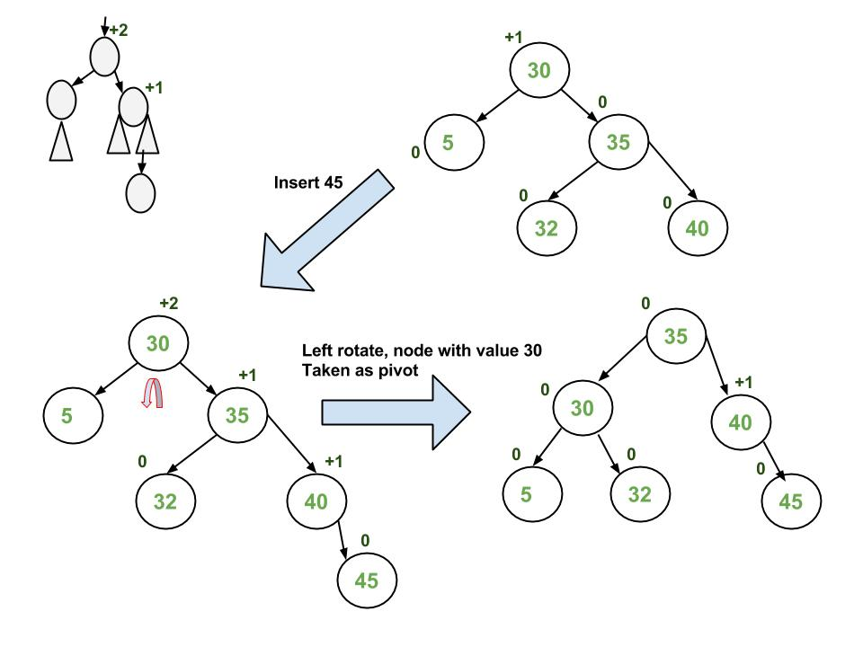
2. Balanced Search Trees . . .
Insert Operation in an AVL Tree . . .Illustration . . .

Slide 21
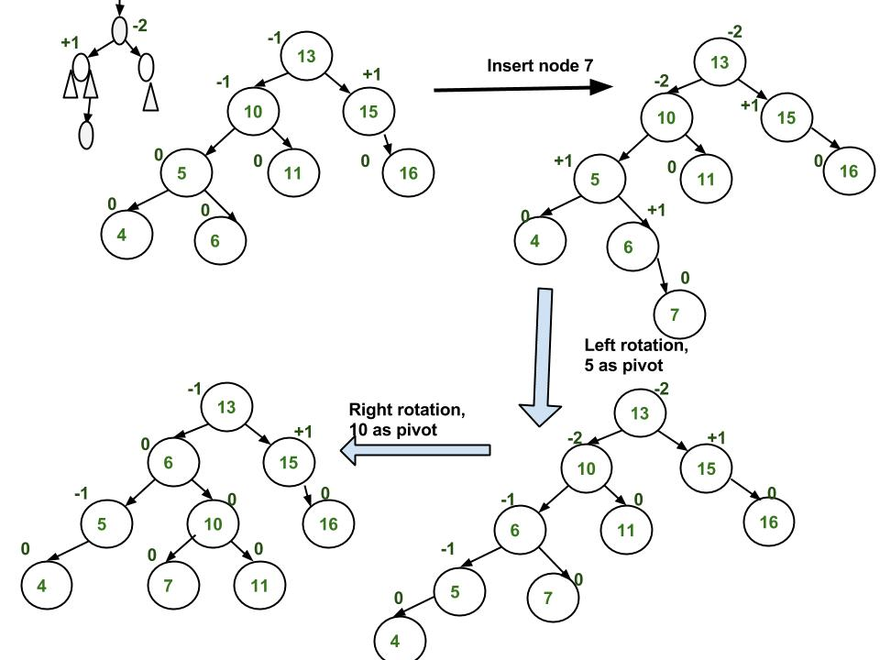
2. Balanced Search Trees . . .
Insert Operation in an AVL Tree . . .Illustration . . .

Slide 22
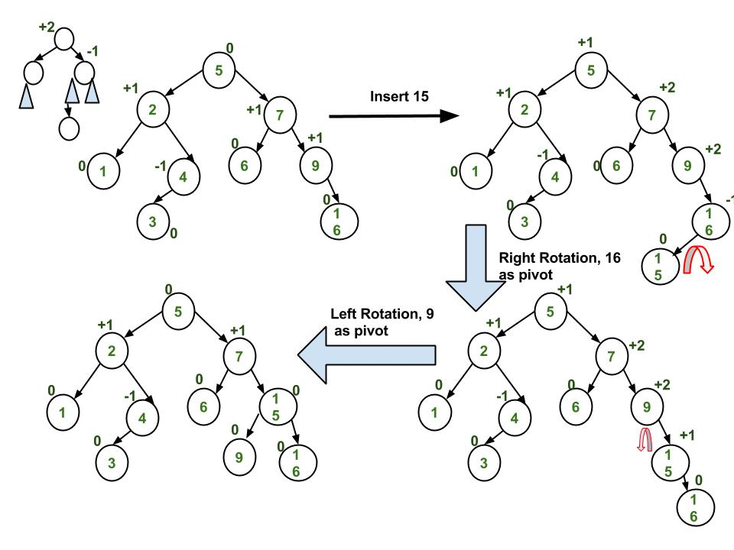
2. Balanced Search Trees . . .
Insert Operation in an AVL Tree . . .Illustration . . .

Slide 23
2. Balanced Search Trees . . .
Advantages of AVL Tree:
AVL trees can self-balance themselves and therefore provides time complexity as O(Log n) for search, insert and delete.
It is a BST only (with balancing), so items can be traversed in sorted order.
Since the balancing rules are strict compared to Red Black Tree, AVL trees in general have relatively less height and hence the search is faster.
AVL tree is relatively less complex to understand and implement compared to Red Black Trees.
Disadvantages of AVL Tree:
It is difficult to implement compared to normal BST and easier compared to Red Black
Less used compared to Red-Black trees.
Due to its rather strict balance, AVL trees provide complicated insertion and removal operations as more rotations are performed.

Slide 24
2. Balanced Search Trees . . .
When to Use Rotations and Which Type :
How to decide when you need a tree rotation is usually easy, but determining which type of
rotation you need requires a little thought.
A tree rotation is necessary when you have inserted or deleted a node which leaves the tree in an unbalanced state.
Balance factor of a tree with a left subtree A and a right subtree B is height(B)-height(A)
Right Heavy Tree:
In figure above, the tree has a balance of 2 - the tree is considered "right heavy".
We can correct this by performing what is called a "left rotation". How we
1
2
3

Slide 25
2. Balanced Search Trees . . .
When to Use Rotations and Which Type : . . .
How we determine which rotation to use follows a few basic rules:
IF tree is right heavy
{
IF tree's right subtree is left heavy
{
Perform Double Left rotation
}
ELSE
{
Perform Single Left rotation
}
}
ELSE IF tree is left heavy
{
IF tree's left subtree is right heavy
{
Perform Double Right rotation
}
ELSE
{
Perform Single Right rotation
}
}

Slide 26
Chapter – 6
Transform and Conquer
Contents
Presorting,
Balanced Search Trees,
Heaps and Heapsort,
Problem Reduction

Slide 27
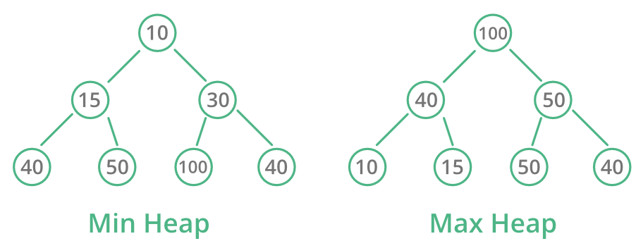
3. Heaps & Heap Sort.
Heap is a complete binary tree data structure that satisfies the heap property: for every node, the value of its children is greater(or smaller) than or equal to its own value.
Heaps are usually used to implement priority queues, where the smallest (or largest) element is always at the root of the tree.

Slide 28
3. Heaps & Heap Sort.. . .
There are two main types of heaps:
Max-Heap: The value of each node is greater than or equal to the values of its children, ensuring that the root node contains the maximum value. As you move down the tree, the values decrease.
Min-Heap: The value of each node is less than or equal to the values of its children, ensuring that the root node contains the minimum value. As you move down the tree, the values increase.

Slide 29
3. Heaps & Heap Sort.. . .
Heap Operations - Common heap operations are:
Insert: Adds a new element to the heap while maintaining the heap property.
Extract Max/Min: Removes the maximum or minimum element from the heap and returns it.
Heapify: Converts an arbitrary binary tree into a heap.

Slide 30
3. Heaps & Heap Sort.. . .
Heap Applications :
Heaps are commonly used to implement priority queues, where elements are retrieved based on their priority (maximum or minimum value).
Heapsort is a sorting algorithm that uses a heap to sort an array in ascending or descending order.
Heaps are used in graph algorithms like Dijkstra’s algorithm and Prim’s algorithm for finding the shortest paths and minimum spanning trees.

Slide 31
3. Heaps & Heap Sort.. . .
Heap Sort :
Heap sort is a comparison-based sorting technique based on Heap Data Structure(an Array).
It can be seen as an optimization over selection sort where we first find the max (or min) element and swap it with the last (or first).
Heap Sort Algorithm:
Rearrange array elements so that they form a Max Heap.
Repeat the following steps until the heap contains only one element:
Swap the root element of the heap (which is the largest element in current heap) with the last element of the heap.
Remove the last element of the heap (which is now in the correct position). We mainly reduce heap size and do not remove element from the actual array.
Heapify the remaining elements of the heap.

Slide 32
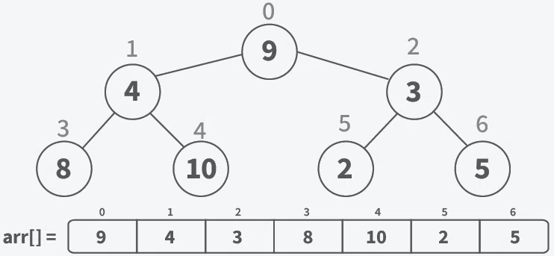
3. Heaps & Heap Sort.. . .
Working of Heap Sort:
Step 0: Treat the Array as a Complete Binary Tree
Visualize the array as a complete binary tree. For an array of size n, the root is at index 0, the left child of an element at index i is at 2i + 1, and the right child is at 2i + 2.

Slide 33
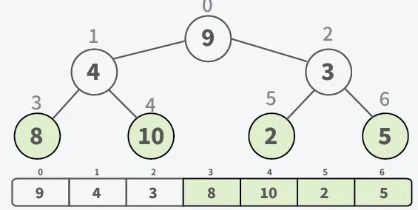
3. Heaps & Heap Sort.. . .
Working of Heap Sort: . . .
Step 1: Build a Max Heap – Heapify
Starting from lastLevel -1, ensure parent nodes are larger, by swapping the larger child with the parent to keep up the heap property.

Slide 34
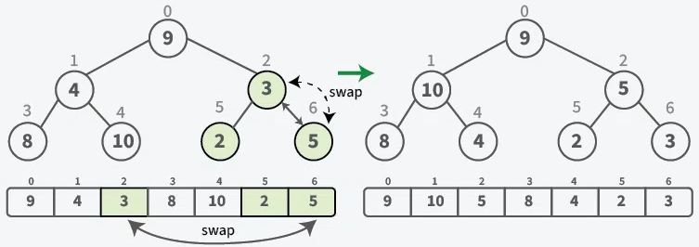
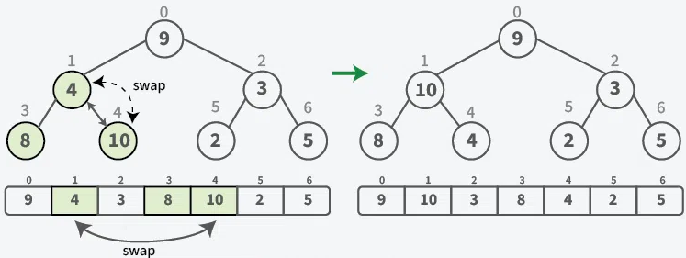
3. Heaps & Heap Sort.. . .
Working of Heap Sort: . . .
Step 1: Build a Max Heap – Heapify . . .
Starting from lastLevel -1, ensure parent nodes are larger, bys wapping the larger child with the parent to keep up the heap property.

Slide 35
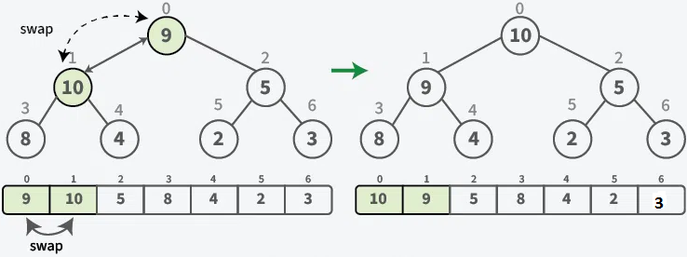
3. Heaps & Heap Sort.. . .
Working of Heap Sort: . . .
Step 1: Build a Max Heap – Heapify . . .
Starting from lastLevel -1, ensure parent nodes are larger, bys wapping the larger child with the parent to keep up the heap property.

Slide 36
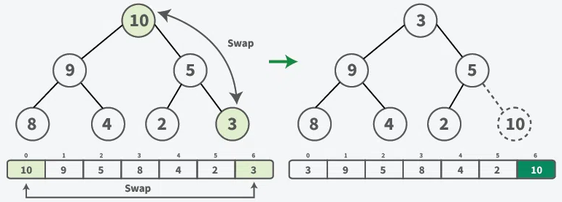
3. Heaps & Heap Sort.. . .
Working of Heap Sort: . . .
Step 2: Sort the array by placing largest element at end of unsorted array.
Swap the maximum element (node-10) with the last element (node-3) in the unsorted array.
Decrease the size of the heap by 1 - Ignore the last element as it is now sorted.

Slide 37
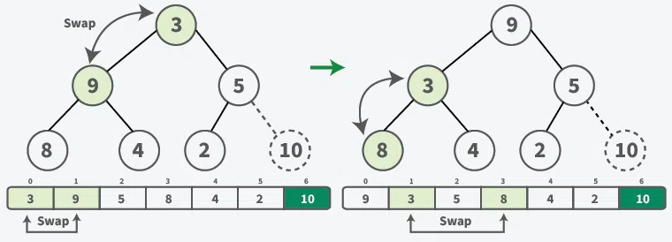
3. Heaps & Heap Sort.. . .
Working of Heap Sort: . . .
Step 2: Sort the array by placing largest element at end of unsorted array . . .
As root violates the heap property - Heapify the tree:
Swap node -3 with its largest child,node-9.
Further, swap node-3 with largest child, node -8.

Slide 38
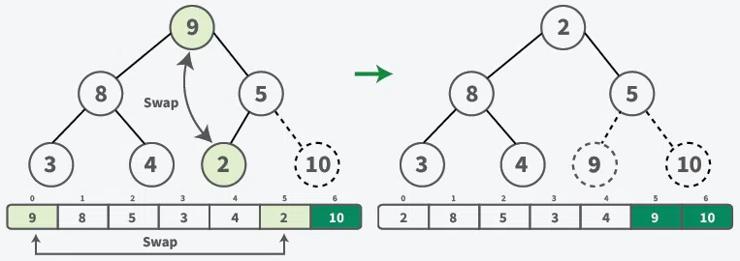
3. Heaps & Heap Sort.. . .
Working of Heap Sort: . . .
Step 2: Sort the array by placing largest element at end of unsorted array . . .
Swap the maximum element (node-9) with the last element(node-2) in the unsorted array.
Decrease the size of the heap by 1 - Ignore the second last element as it is now sorted.

Slide 39
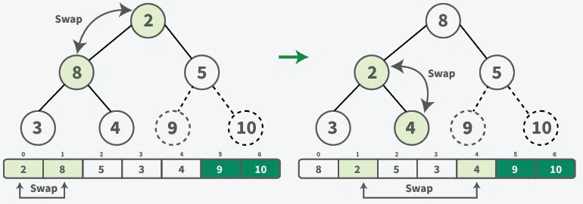
3. Heaps & Heap Sort.. . .
Working of Heap Sort: . . .
Step 2: Sort the array by placing largest element at end of unsorted array . . .
As root violates the heap property - Heapify the tree:
Swap node -2 with its largest child,node-8.
Further, swap node-2 with largest child, node -4.

Slide 40
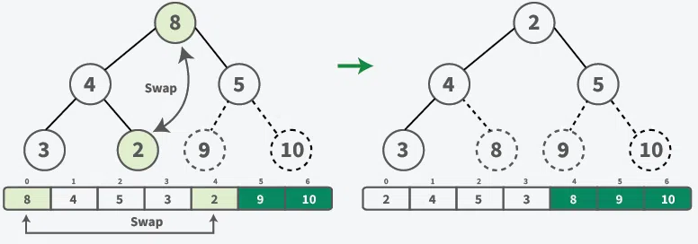
3. Heaps & Heap Sort.. . .
Working of Heap Sort: . . .
Step 2: Sort the array by placing largest element at end of unsorted array . . .
Swap the maximum element (node-8) with the last element(node-2) in the unsorted array.
Decrease the size of the heap by 1 - Ignore the third last element as it is now sorted.

Slide 41
References
https://www.scaler.com/topics/c-data-structures/
https://www.javatpoint.com/primitive-vs-non-primitive-data-structure
https://www.javatpoint.com/merge-sort
https://www.geeksforgeeks.org/
https://www.shiksha.com/online-courses/articles/quicksort-algorithm-with-code/

Slide 42

! Thank You !

